Slide 1
TREAT Treating HIV positive transgender women in partnership with key population-led community based organizations in Thailand
Reshmie Ramautarsing, M.D., Ph.D.
PREVENTION - Thai Red Cross AIDS Research Centre

Slide 2
Majority of new infections are among men who have sex with men and transgender women

Slide 3
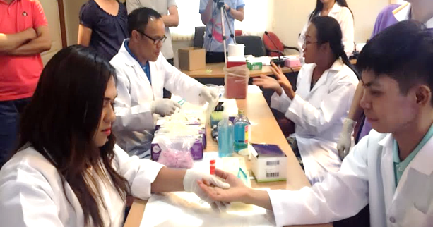
Key Population-Led Health Services (KPLHS)
“KP Community leadership”: Needs-based, demand-driven, and client-centered
KP-LHS is a true partnership between CBOs and government/public health facilities
“Every time I provide counseling service, I feel like I’m helping someone in my own family” Dusit Meekrua
Community health workers (CHWs) provide “certain” health services:
Counseling, testing and reporting of HIV test results, STI sampling, point-of-care CD4, TB screening
PrEP and PEP
Source: FrontLines, March/April 2016, Dressed to Test: Empowered Communities Take HIV Services to the Streets

Slide 4
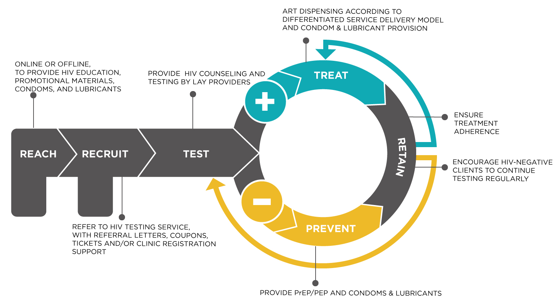
KPLHS Reach, Recruit, Test, Treat and Prevent-Retain

Slide 5
Early diagnosis and early initiation of ART among transgender women (TGW)
Median CD4 at diagnosis: 452 (IQR: 306-582) cells/mm³
Median time from diagnosis to initiation: 14.5 days (IQR:7.0-23.3)
Close collaboration and mutual trust between CBO testing sites and referral ART hospitals
Source: TRC Community-Led Test and Treat Study among Thai MSM and TG

Slide 6
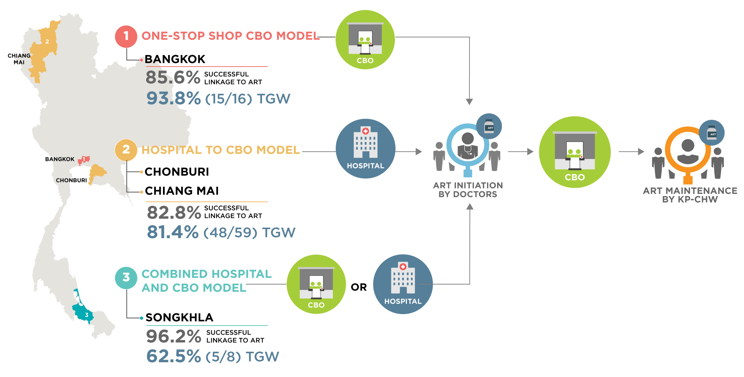
KPLHS includes three models of differentiated ART service delivery

Slide 7
Differentiated ART delivery for transgender women
More details on page 29 of “A Decision Framework for differentiated ART delivery for key populations”

Slide 8
KPLHS: Client satisfaction in DSD ART

Slide 9
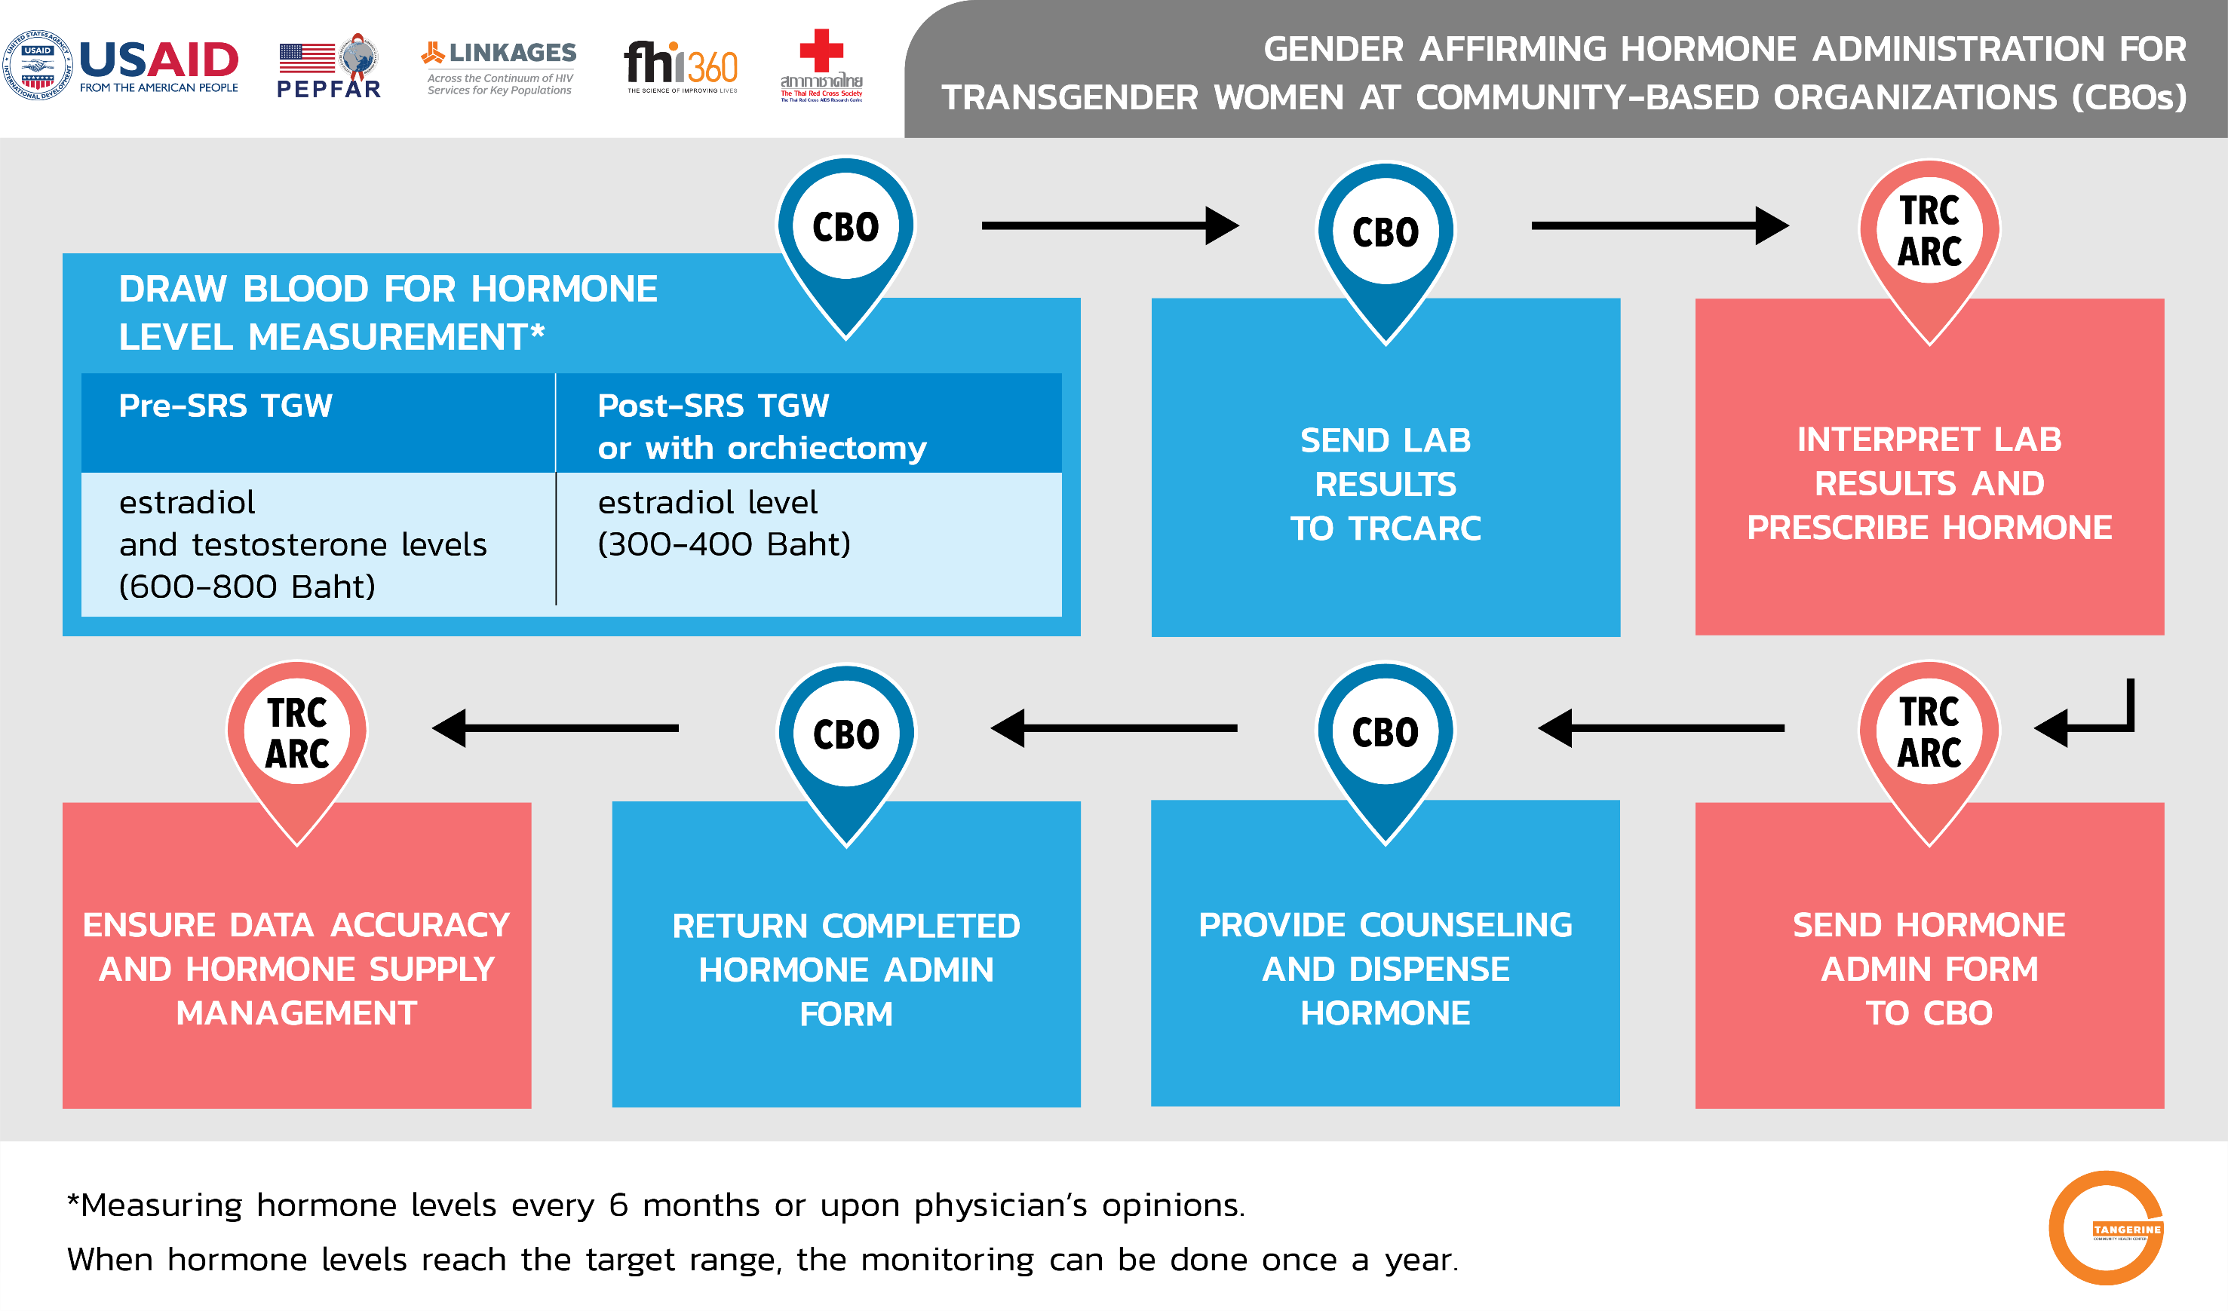
Tailoring services to the needs of transgender women

Slide 10
Conclusions
KPLHS is feasible and effective in enhancing the uptake of services along the entire HIV cascade, including differentiated ART maintenance among high risk transgender women
High client satisfaction rates among key populations receiving differentiated ART services
ART initiation and retention in care for HIV+ transgender women remains challenging

Slide 11
Next steps
Qualitative assessment of client and provider satisfaction on DSD ART services to further tailor services
Wednesday 25 July 12:30 poster WEPEE768
Hormone monitoring services at the CBOs
Thursday 26 July 15:15 oral abstract THAC0204
Development of mobile application to enhance retention in care and allow for telemedicine services

Slide 12
Acknowledgements
This work was made possible by the generous support of the American people through the United States Agency for International Development (USAID) and the U.S. President’s Emergency Plan for AIDS Relief (PEPFAR). The contents are the responsibility of the LINKAGES project and do not necessarily reflect the views of USAID, PEPFAR, or the United States Government. LINKAGES, a five-year cooperative agreement (AID-OAA-A-14-00045), is led by FHI 360 in partnership with IntraHealth International, Pact, and the University of North Carolina at Chapel Hill.

